Slide 1
STUDENT RECORD MANAGER
Submitted by:
Ankush Gautam [313625]
Kabir Bhattarai [313644]
Kiran Sharma Panthi [313646]

Slide 2
ACKNOWLEDGEMENT
First of all, we would like to express our sincere gratitude to Gomendra Multiple College for providing us the opportunity to pursue higher education in such a wonderful academic environment. We are indebted to Mr. Rupak Khanal (Principal, G.M. College) who granted our project work by understanding the need of student and encouraging us in every aspect of our academic study.
We are grateful to our respected project teacher Mr. Bhawesh Kafle for his persistence help and clear guidance throughout our academic study and completion of this project. His suggestions and guidance in every stage is one of the major reasons for the successful completion of our project. Without his proper guidance, our project would not have been accomplished in time.

Slide 3
INTRODUCTION
“Student Record Manager” is a desktop application written in C Language. The main objective of this project is to manage the details of students and calculate their marks. Besides, the program can also add, record, edit, search, delete, calculate grades and sort the details of all the students as per the requirement.
The application begins with a setup page which asks the user to setup the program if it is the first time the Application is running. The user needs to entered the school’s name, address of the school, course name (E.g. BCA, BBA), number of subjects and name of all the subjects. These details will only be asked Once. The user also needs to sign up and input the desire username and password. And, after the setup, the user will land on the main menu of the program. In the main menu, the user can choose from a various option according to the need of the user.

Slide 4
PROBLEM STATEMENT
Today most of the school use computers to calculate and store records of students. But when it comes to calculate marks of every single student and store it, it becomes troublesome as we need different heavy software or pay subscription to use such applications. We even have to remember formulas and should know how to operate such software.
Therefore, we decided to make a simple application which does this kind of job in a matter of seconds and is simple and easy to use. User doesn’t need to have a vast knowledge to use this application nor do they have to remember any kind of formulas or code to operate this program. A basic knowledge of computer is enough to operate this program and user just need to input records of students and all the other calculation and sorting things will be done automatically.

Slide 5
OBJECTIVE
To provide a user-friendly program
To provide simple and easy interface
To provide fast operations like sorting and displaying grade-sheet
To increase productivity and efficiency
To provide a light-weighted free of cost program

Slide 6
HARDWARE & SOFTWARE REQUIREMENT
Minimum hardware requirements for efficient operation of this project:
Processor : Pentium and above
Hard disk : 50MB or above free space
RAM : 128MB or above
Minimum software requirements for efficient operation of this project:
As this program is written in C language, so the IDE already compiles the code and provide us an executable file. So, we don’t need any software to run this application. We don’t even need a C based IDE to run as long as we have the executable file (.exe file).
Operating system : WINDOWS 98 or above
Program Application : StudentRecordManager.exe

Slide 7
JOBWISE SCHEDULE
Member 1: Ankush Gautam
JOB ID | JOB DESCRIPTION | DATE FROM | DATE TO
A1 | Programming, Designing, Editing, Debugging | Kartik 23, 2078 | Poush 30, 2078
A2 | Documentation | Poush 25, 2078 | Magh 10, 2078

Slide 8
JOBWISE SCHEDULE
Member 2: Kabir Bhattarai
JOB ID | JOB DESCRIPTION | DATE FROM | DATE TO
A1 | Programming, Debugging | Kartik 23, 2078 | Poush 30, 2078
A2 | Documentation | Poush 25, 2078 | Magh 10, 2078

Slide 9
JOBWISE SCHEDULE
Member 3: Kiran Sharma Panthi
JOB ID | JOB DESCRIPTION | DATE FROM | DATE TO
A1 | Programming, Debugging | Kartik 23, 2078 | Poush 30, 2078
A2 | Documentation | Poush 25, 2078 | Magh 10, 2078

Slide 10
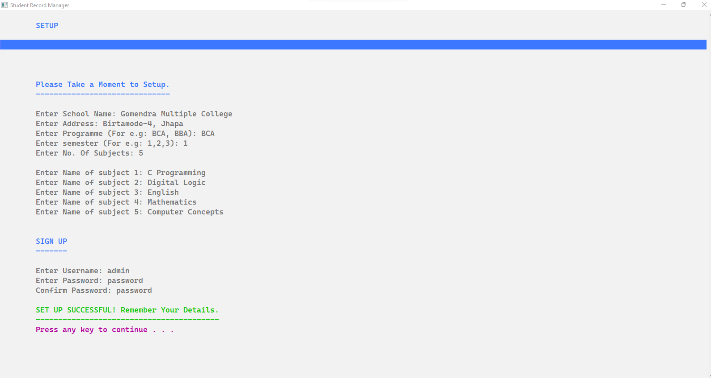
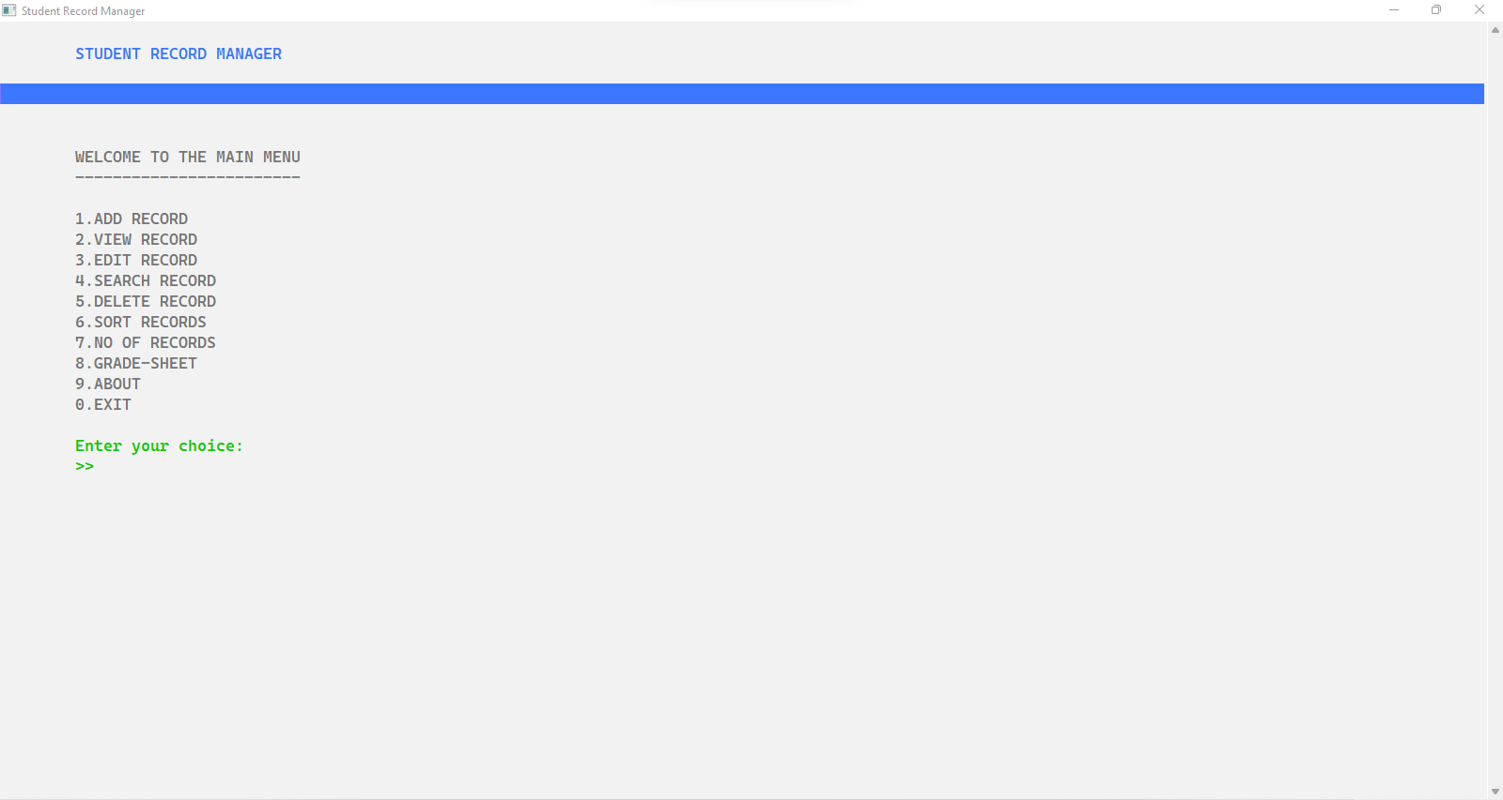
Screenshots of Program
First picture in the top is of SETUP page where the User needs to input details about the school and number of subject he/she wants to have. Additionally, user also needs to sign up to login next time the program is opened.
Second picture is of the MAIN MENU where user can choose a particular number to perform a certain task. For example, User can press 1 to add record of a student or press 2 to view all the records the user has stored.

Slide 11
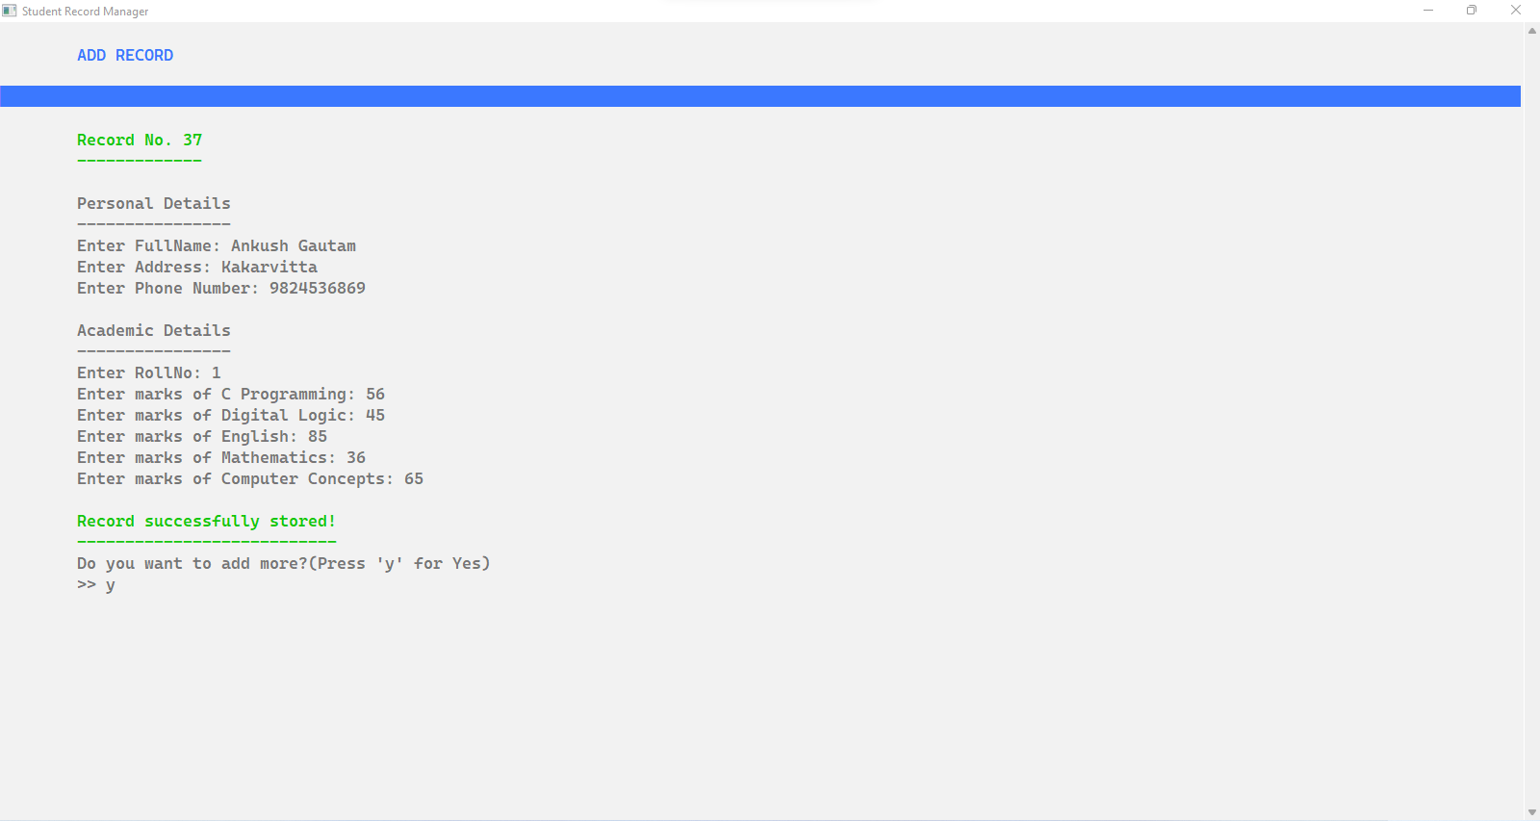
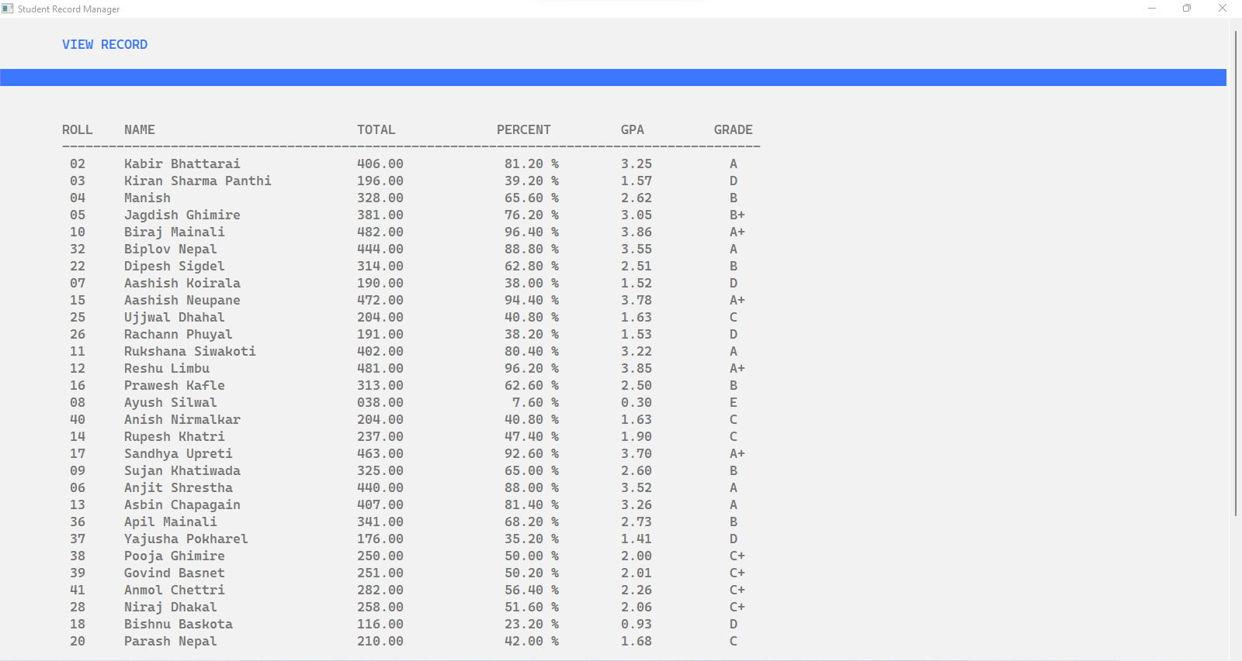
Screenshots of Program
ADD RECORD as the name suggests helps to input details of students like name, phone number, address, roll etc.
VIEW RECORD displays all the records that are stored in the file after adding record. We can view roll number, name, total marks and percentage of all the students.

Slide 12
CONCLUSION
We tried to make a simple yet effective program and we think we kind of were successful. But, every program has a room for further improvement so any kind of feedback is most welcomed.
We would again like to thank our respected teacher Mr. Bhawesh Kafle for consistent support and help. We are also thankful to our classmate for being so creative and helpful that makes us to push ourselves further and learn more every day.
So, Thank you everyone for your time.
- Ankush Gautam, Kabir Bhattarai, Kiran Sharma

Slide 13
REFRENCES
Online
https://www.geeksforgeeks.org/c-programming-language
https://stackoverflow.com
https://www.tutorialspoint.com/cprogramming
https://www.youtube.com/watch?v=ytGATjX3nqc&ab_channel=EngineerMan
https://www.youtube.com/watch?v=L00f3z7WBRU&ab_channel=Brightgoal
Books
Introduction to C Programming
Computer Essentials

